Slide 1
Performance Metrics
CSE451:Neural Network & Fuzzy Logic
MD Tamim Hossain
Lecturer
Department of Computer Science and Engineering
Premier University
“The most important thing is to enjoy your life - to be happy - it's all that matters”
-Audrey Hepburn

Slide 2
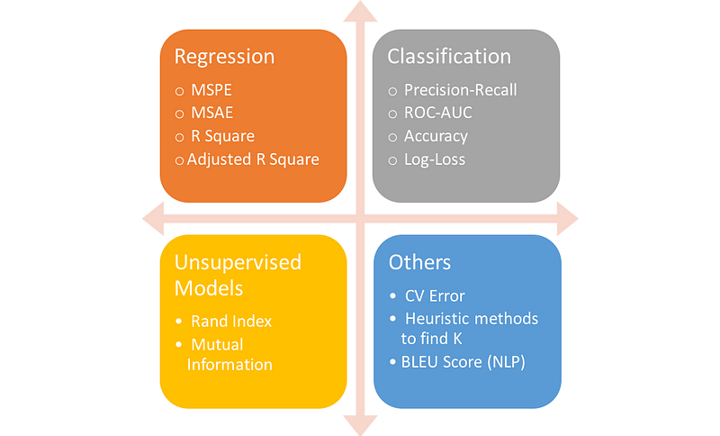
Performance Metrics
Evaluate the performance or quality of the model
Help us understand how well our model has performed for the given data
Help determine how well the model generalizes on the new dataset.

Slide 3
Performance Metrics for Classification
Accuracy
Confusion Matrix
Precision
Recall
F-Score
AUC(Area Under the Curve)-ROC

Slide 4

Accuracy
Simplest Classification metrics to implement
The number of correct predictions to the total number of predictions.
Accuracy rate is 99%!
Is the Model is Good?

Slide 5
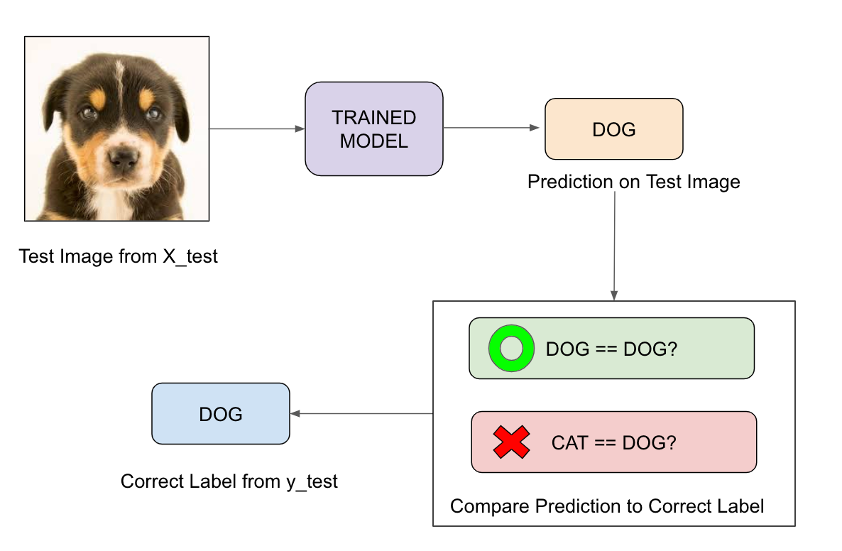
Quick Revision

Slide 6
Accuracy
Imagine we had 99 images of the dog and only 1 image of a cat in our training data, our model would be simply a line that always predicted dog, and therefore we got 99% accuracy
A single metric won’t tell the whole story!
Data is always imbalanced in reality

Slide 7
When to Use Accuracy?
When the target variable classes in data are approximately balanced
For example, if 60% of classes in a fruit image dataset are of Apple, 40% are Mango. In this case, if the model is asked to predict whether the image is of Apple or Mango, it will give a prediction with 97% of accuracy.

Slide 8
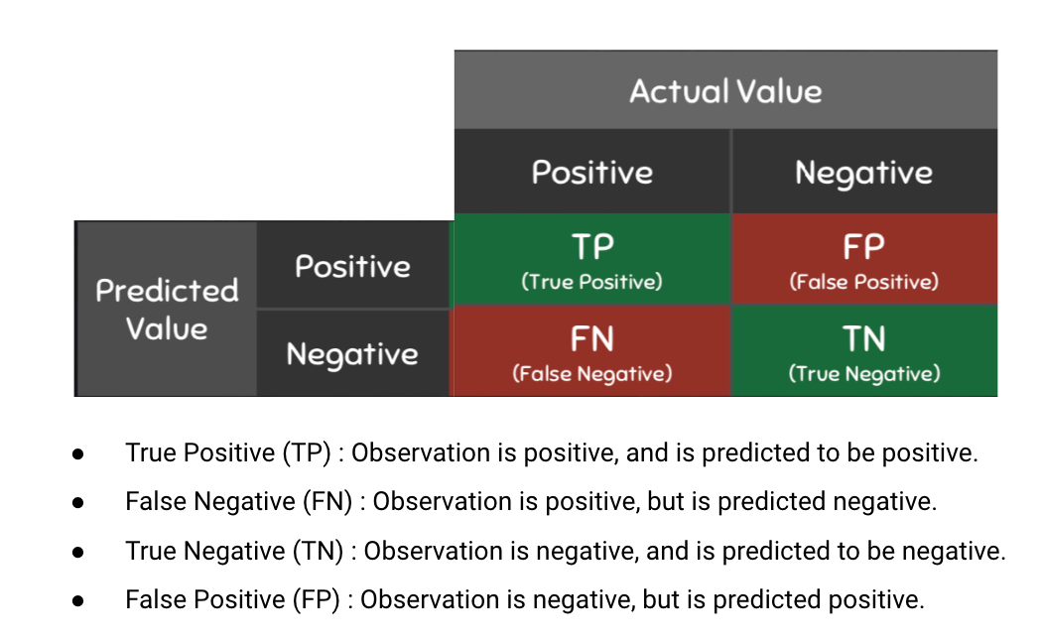
Confusion Matrix
Tabular representation of prediction outcomes of any binary classifier
Used to describe the performance of the classification model on a set of test data when true values are known

Slide 9
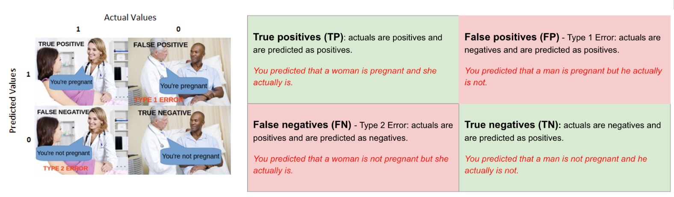
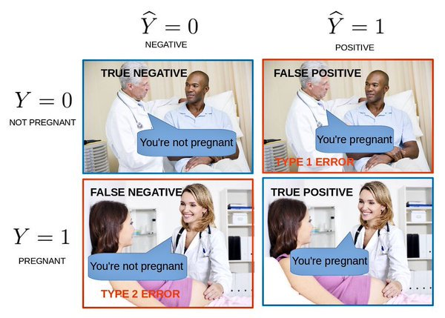
Do you feel confused?

Slide 10
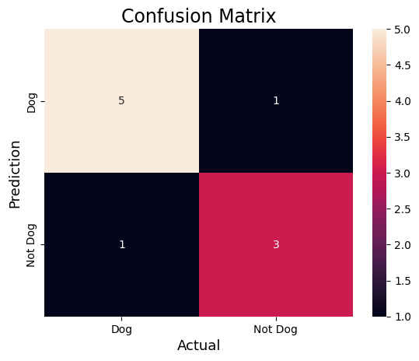
Binary classifier CM
It can be extended to use for classifiers with more than two classes

Slide 11
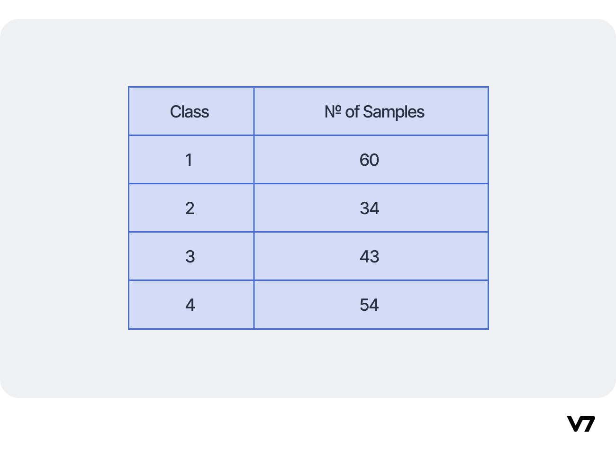
Multiclass Classifier

Slide 12
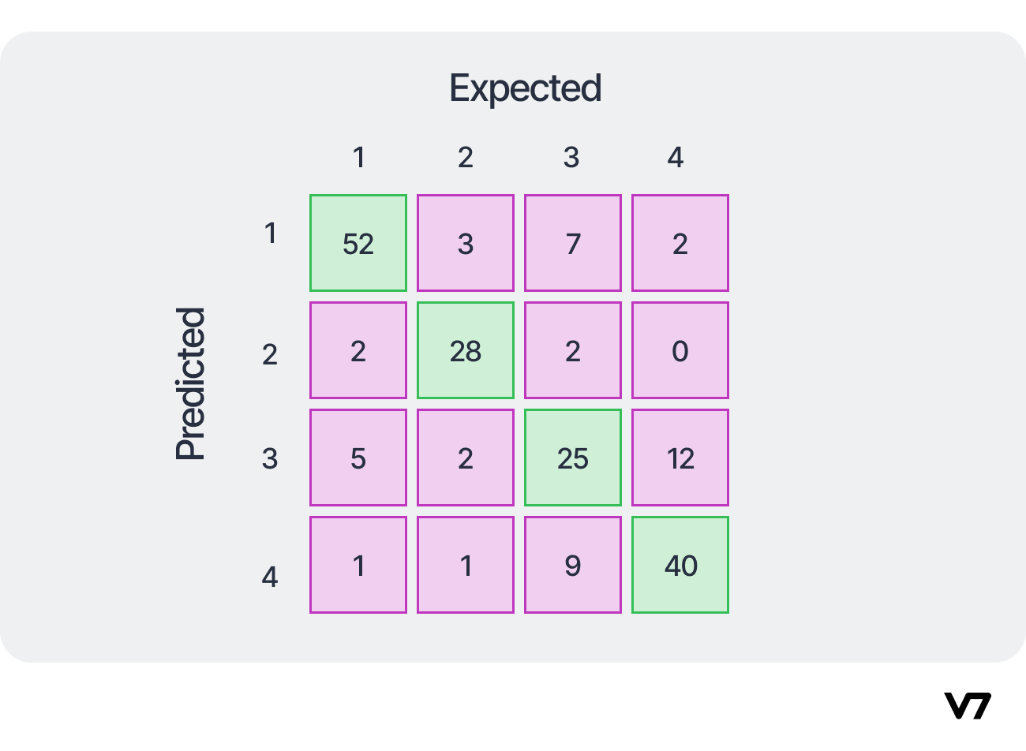
Confusion Matrix

Slide 13
Observation
A total of 145 samples were correctly predicted out of the total 191 samples. Thus, the overall accuracy is 75.92%.
M_24=0 implies that the model does not confuse samples originally belonging to class-4 with class-2
To improve the model’s performance, one should focus on the predictive results in class-3. A total of 18 samples were misclassified by the classifier, which is the highest misclassification rate among all the classes.
Accuracy in prediction for class-3 is, thus, 58.14% only.

Slide 14
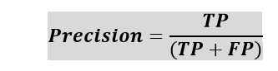
Precision
The precision metric is used to overcome the limitation of Accuracy
Determines the proportion of positive prediction that was actually correct
Ratio of True Positives to all the positives predicted by the model
Low precision: the more False positives the model predicts, the lower the precision

Slide 15

Recall or Sensitivity
Similar to the Precision metric
Calculate the proportion of actual positive that was identified incorrectly
Ratio of True Positives to all the positives in your Dataset
Low recall: the more False Negatives the model predicts, the lower the recall

Slide 16
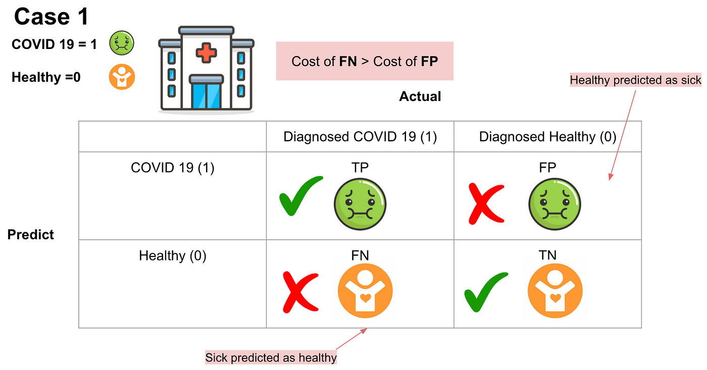
Idea of recall and precision
Which scenario do you think will have the highest cost?

Slide 17
Idea of recall and precision
The cost of false negatives is much higher than the cost of false positives
Imagine that if we predict COVID-19 residents as healthy patients and they do not need to quarantine, there would be a massive number of COVID-19 infections.

Slide 18
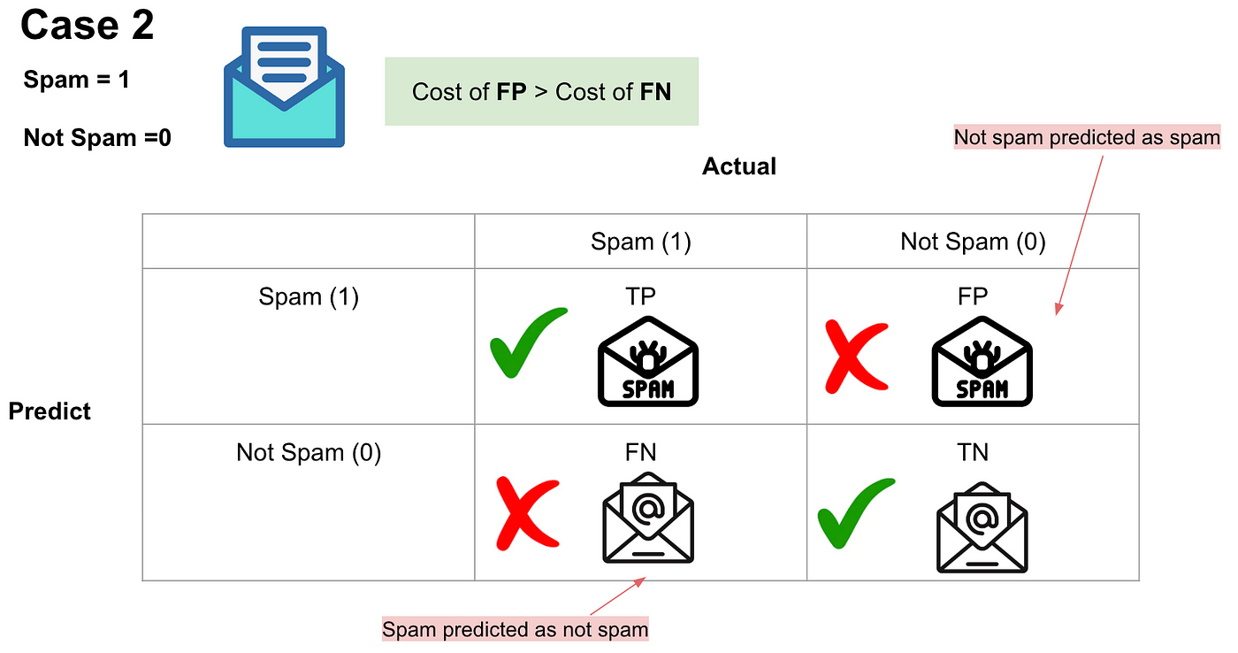
Idea of recall and precision
Which scenario do you think will have the highest cost?

Slide 19
Idea of recall and precision
FP will have a higher cost than FN
Since missing important emails will clearly be more of a problem than receiving spam

Slide 20
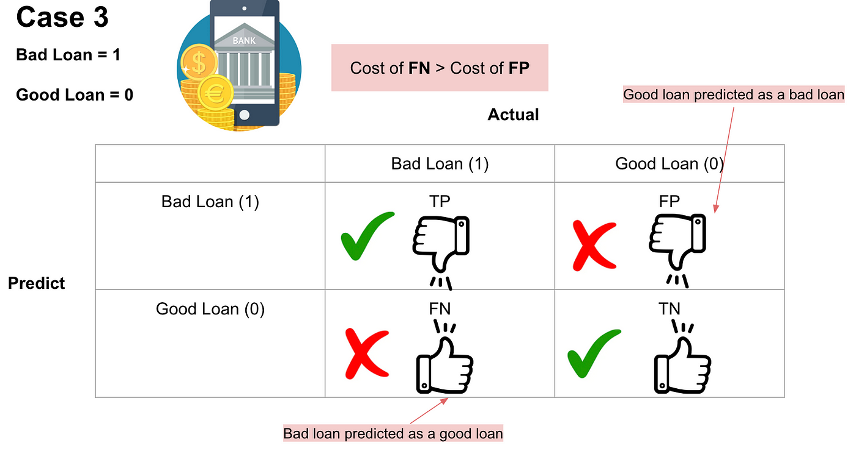
Idea of recall and precision
Which scenario do you think will have the highest cost?

Slide 21
Idea of recall and precision
The cost of False Negatives is much higher than the cost of False Positives
The banks would lose a bunch amount of money if the actual bad loans are predicted as good loans due to loans not being repaid. On the other hand, banks won't be able to make more revenue if the actual good loans are predicted as bad loans

Slide 22
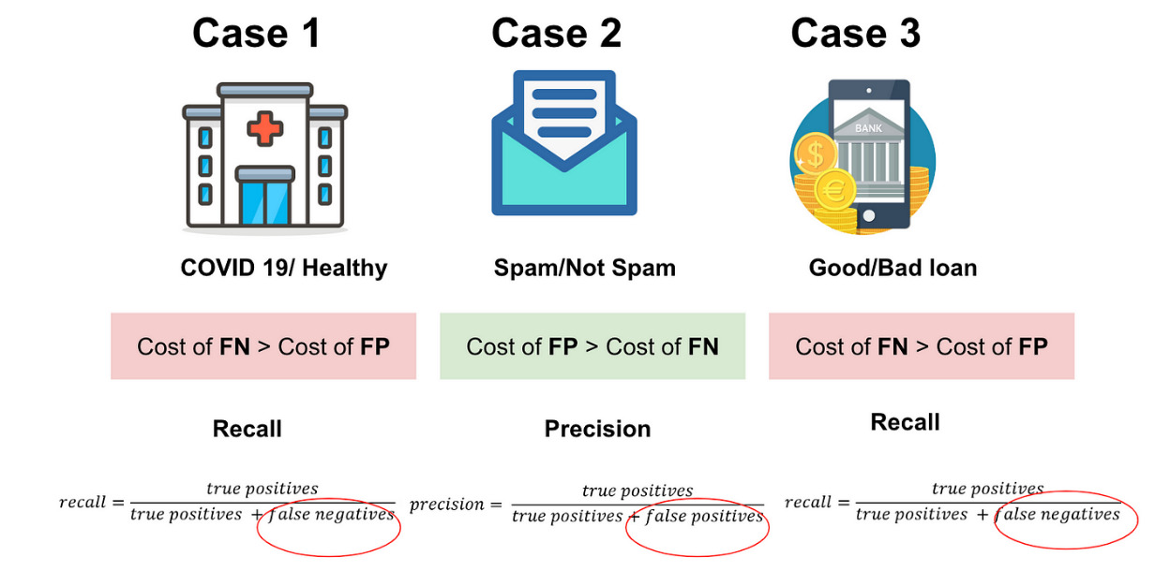
Summary
In practice, the cost of false negatives is not the same as the cost of false positives, depending on the different specific cases. It is evident that not only should we calculate accuracy, but we should also evaluate our model using other metrics, for example, Recall and Precision.

Slide 23
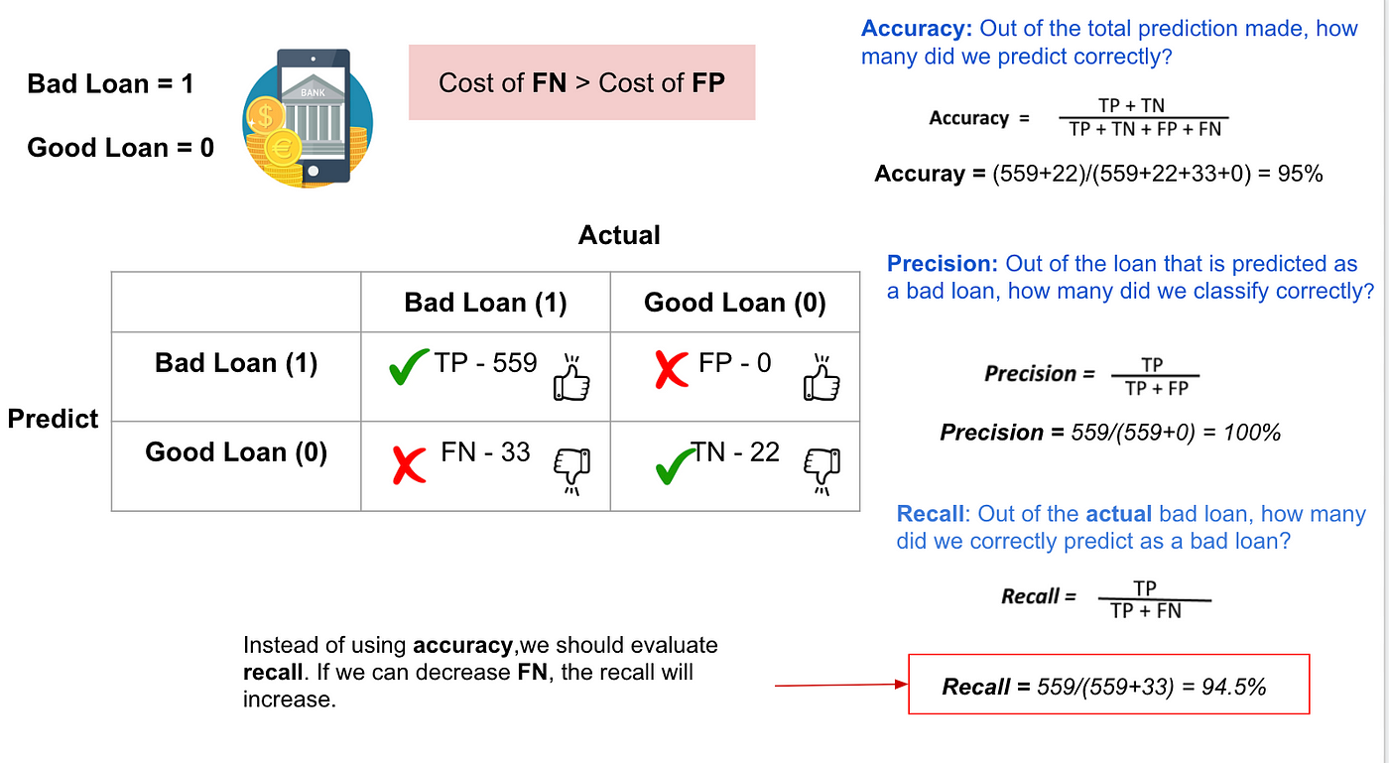
Precision and Recall

Slide 24
When to use Precision and Recall?
If we want to minimize the false negative, then, Recall should be as near to 100%,
If we want to minimize the false positive, then precision should be close to 100% as possible.
If we maximize precision, it will minimize the FP errors
If we maximize recall, it will minimize the FN error.

Slide 25
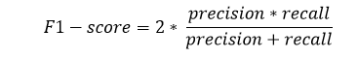
F1-Scores
The harmonic mean of both precision and Recall, assigning equal weight to each of them.
A good F1 score means that you have low false positives and low false negatives
An F1 score is considered perfect when it’s 1, while the model is a total failure when it’s 0.

Slide 26
When to use F1-Score?
If both of them are important for evaluation, but one (precision or recall) is slightly more important to consider than the other
For example, when False negatives are comparatively more important than false positives, or vice versa.

Slide 27
Performance Metrics for Regression
Mean Absolute Error
Mean Squared Error
R2 Score
Adjusted R2

Slide 28

MAE/MSE

Slide 29

Mean Absolute Error (MAE)
One of the simplest metrics
Much more robust for the outliers
One of the limitations of MAE is that it is not differentiable

Slide 30

Mean Squared Error
One of the most suitable metrics for Regression evaluation
It is differentiable and hence optimized better

Slide 31
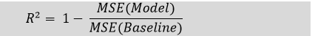
R Squared Score
Known as Coefficient of Determination
Enables us to compare our model with a constant baseline to determine the performance of the model
The R squared score will always be less than or equal to 1 without concerning if the values are too large or small.

Slide 32

*Performance Metrics

